Slide 1
Django 01
Programación Web 2

Slide 2
Do I need to install pip?
“pip is the package installer for Python. You can use pip to install packages from the Python Package Index and other indexes.”
“pip is already installed if you are using Python 2 >=2.7.9 or Python 3 >=3.4 downloaded from python.org or if you are working in a Virtual Environment created by virtualenv or pyvenv. Just make sure to upgrade pip.”
https://packaging.python.org/tutorials/installing-packages/

Slide 3
Virtualenv
https://virtualenv.pypa.io/en/latest/
“The basic problem being addressed is one of dependencies and versions, and indirectly permissions. Imagine you have an application that needs version 1 of LibFoo, but another application requires version 2. How can you use both these libraries? If you install everything into your host python (e.g. python3.8) it’s easy to end up in a situation where two packages have conflicting requirements.”
pip3 install virtualenv
https://virtualenv.pypa.io/en/latest/installation.html
https://stackoverflow.com/questions/41573587/what-is-the-difference-between-venv-pyvenv-pyenv-virtualenv-virtualenvwrappe

Slide 4
Usando virtualenv
https://virtualenv.pypa.io/en/latest/user_guide.html
virtualenv -p python3 destino
Crea un entorno virtual para trabajar con python3
Debe ejecutarse dentro de un directorio de trabajo
source destino/bin/activate (para desactivarlo: deactivate)
Activa el entorno virtual de desarrollo
Note que cambia el prompt del shell
Tendrá que repetir este paso cada vez que inicie una nueva terminal
Todo lo que se instale será local y no afectará a la instalación de python en el computador
pip freeze
Muestra las bibliotecas instaladas en el entorno activo actual
pip install Django
Instala Django
Note el resultado de freeze ahora

Slide 5
Why Django?
“With Django, you can take Web applications from concept to launch in a matter of hours. Django takes care of much of the hassle of Web development, so you can focus on writing your app without needing to reinvent the wheel. It’s free and open source.”
“Because Django was developed in a fast-paced newsroom environment, it was designed to make common Webdevelopment tasks fast and easy.”
https://www.djangoproject.com/start/overview/#:~:text=With%20Django%2C%20you%20can%20take,It's%20free%20and%20open%20source.
https://docs.djangoproject.com/es/3.2/intro/overview/

Slide 6
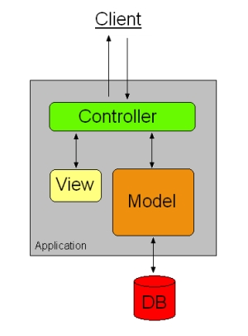

Model View Controller

Slide 7

Creando un primer proyecto en Django
Es importante crear un ambiente virtual dentro de un directorio de trabajo
mkdir src; cd src
source ../bin/activate
django-admin startproject listaContactos .
Crea un nuevo proyecto llamado “listaContactos” con la configuración básica
vim listaContactos/settings.py
Es importante actualizar la información de la configuración
LANGUAGE_CODE = 'es'
TIME_ZONE = 'America/Lima'
python manage.py runserver
https://docs.djangoproject.com/es/3.2/intro/tutorial01/#creating-a-project

Slide 8
Migraciones
Migrations are Django’s way of propagating changes you make to your models (adding a field, deleting a model, etc.) into your database schema. They’re designed to be mostly automatic, but you’ll need to know when to make migrations, when to run them, and the common problems you might run into.
python manage.py migrate
Actualiza los cambios hechos en el proyecto
Sincroniza el trabajo con la base de datos elegida
No hay que diseñar tablas o relaciones
Cambiar de SGBD es muy simple
https://docs.djangoproject.com/es/3.2/topics/migrations/

Slide 9
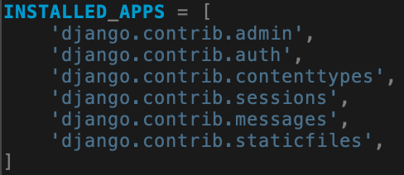
Projects and applications
https://docs.djangoproject.com/es/3.2/ref/applications/
The term project describes a Django web application. The project Python package is defined primarily by a settings module, but it usually contains other things.
A project’s root directory (the one that contains manage.py) is usually the container for all of a project’s applications which aren’t installed separately.
The term application (app) describes a Python package that provides some set of features. Applications may be reused in various projects.

Slide 10
Creación de Apps en Django
Creates a Django app directory structure for the given app name in the current directory or the given destination.
django-admin startapp personas
personas/
├── __init__.py
├── admin.py
├── apps.py
├── migrations
│ └── __init__.py
├── models.py
├── tests.py
└── views.py
https://docs.djangoproject.com/es/3.2/ref/django-admin/#startapp
Cree sus propias APPs, no tenga temor de experimentar

Slide 11
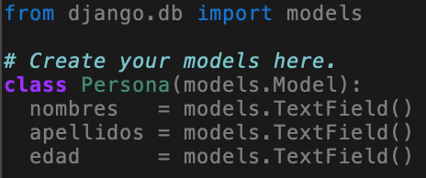
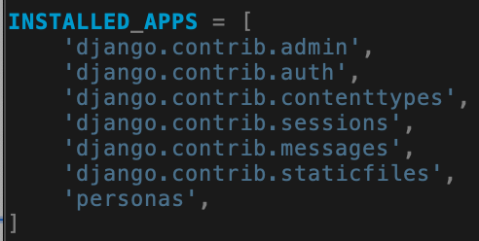
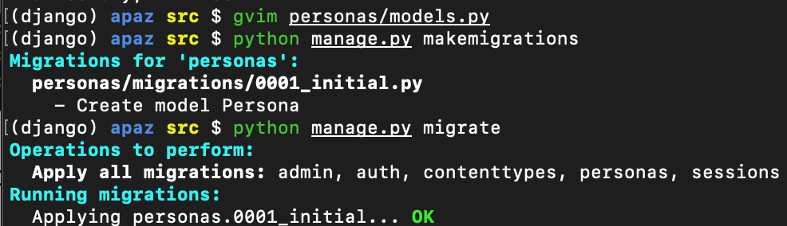
vim personas/models.py
https://docs.djangoproject.com/es/3.2/intro/tutorial02/#creating-models
Hay que actualizar los cambios hechos e informar al framework
python manage.py makemigrations
python manage.py migrate
¿Qué archivos se modificaron al hacer makemigrations y migrate?
https://docs.djangoproject.com/es/3.2/intro/tutorial02/#activating-models

Slide 12
The Django /admin site
One of the most powerful parts of Django is the automatic admin interface. It reads metadata from your models to provide a quick, model-centric interface where trusted users can manage content on your site. The admin’s recommended use is limited to an organization’s internal management tool. It’s not intended for building your entire front end around.
The admin has many hooks for customization, but beware of trying to use those hooks exclusively. If you need to provide a more process-centric interface that abstracts away the implementation details of database tables and fields, then it’s probably time to write your own views.
https://docs.djangoproject.com/es/3.2/ref/contrib/admin/#:~:text=One%20of%20the%20most%20powerful,an%20organization's%20internal%20management%20tool.

Slide 13
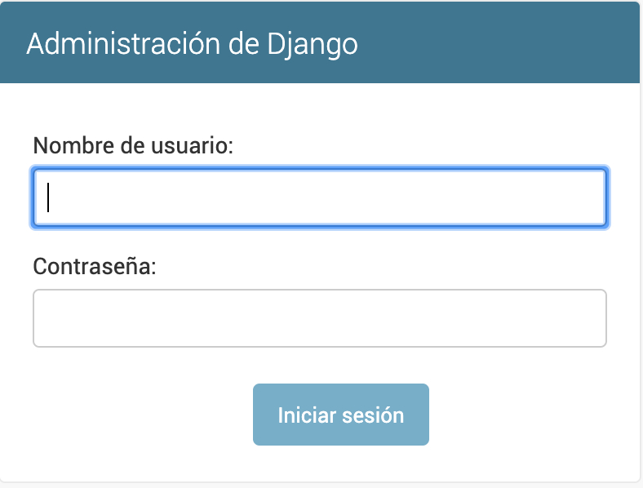
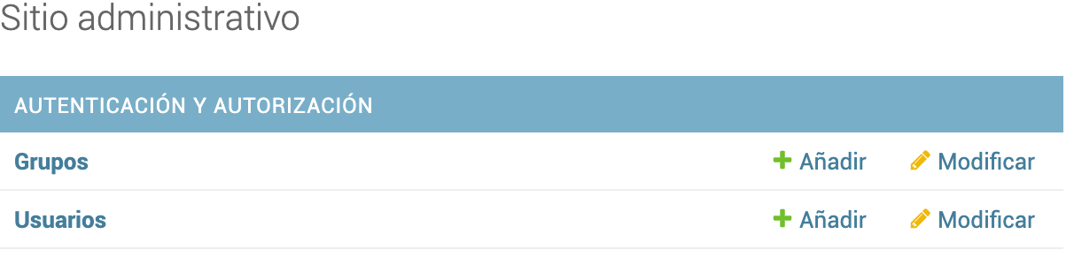
Creando nuevos usuarios
django-admin createsuperuser
python manage.py createsuperuser
Crea un nuevo usuario con su contraseña con permisos de administrador

Slide 14
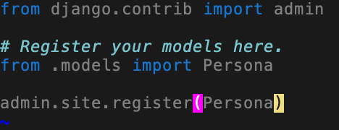
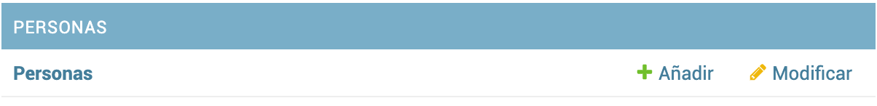
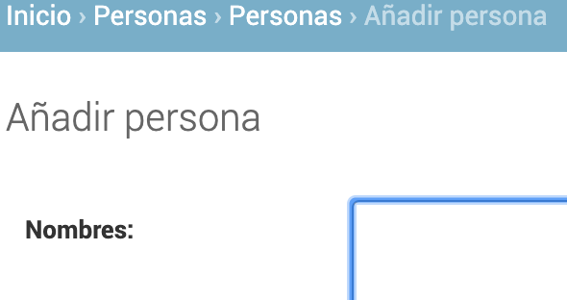
vim personas/admin.py
admin/

Slide 15
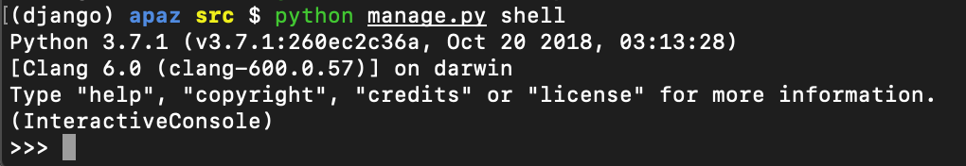
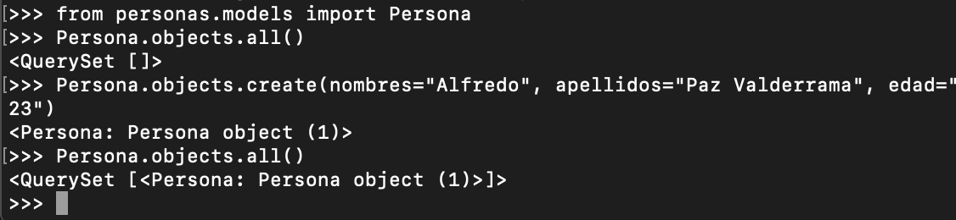
python manage.py shell
¿Qué archivos se modificaron al agregar personas?

Slide 16
Field types
https://docs.djangoproject.com/en/3.2/ref/models/fields/#field-types
CharField
class CharField(max_length=None, **options)[source]
A string field, for small- to large-sized strings.
For large amounts of text, use TextField.
TextField
class TextField(**options)[source]
A large text field. The default form widget for this field is a Textarea.
IntegerField
class IntegerField(**options)[source]
An integer. Values from -2147483648 to 2147483647 are safe in all databases supported by Django.

